Slide 1
Lab2 - Problem Solving by Search
Sam Liu, Lily Hsu, Lily Chiu

Slide 2
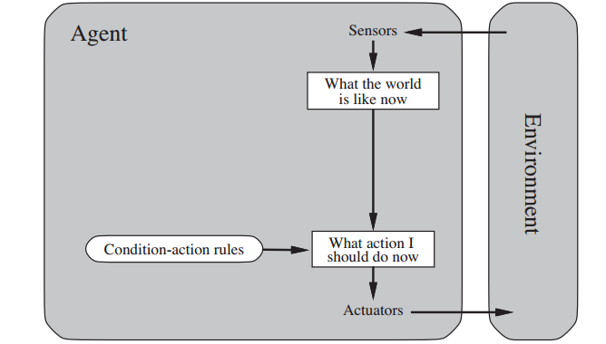
Agent and Environment
Agent
Environment
Sensors
Actuators

Slide 3

State-space Tree
State space tree
Node_N-1
state: s1
action_1
step_cost: 1
action_1
step_cost: 1
Node_N+1
state: s2
Node_N
state: s2
action_2
step_cost: 1
Node_N+1
state: s3
Notes:
Node
State
Transition function
step cost

Slide 4
State-space Tree
Maybe you need to consider:
Initial state, goal state
Which action set can be apply by an agent
What’s the result from executing the given action in the given state.
A function can check that whether the current state is equal to goal state?
(What’s step cost by apply an action?)
(Decide which branch should we follow, which is based on current information.)
How to store and expand the state-space tree?
How to path all tree if we got the goal state?
Notes:
Node
State
Transition function
step cost

Slide 5
Definition of the abstract problem class
How AIMA textbook define abstract class?
__init__() → Initial state, goal state
actions() → Return an action set which can be apply by an agent on a specific state
result() → Return the result state from executing the given action in the given state.
is_goal() → A function is used for checking that whether the current state is equal to goal state?
step_cost() → What’s step cost by apply an action?
h() → Heuristic function: Decide which branch should we follow, which is based on current information
Node_N-1
state: s1
action_1
step_cost: 1
action_1
step_cost: 1
Node_N
state: s2
Node_N+1
state: s2
用來定義問題的規則
action_2
step_cost: 1
Node_N+1
state: s1
Notes:
帶他們看的懂AIMA所使用的Problem架構

Slide 6
Tree node & Queue
How to store and expand the state-space tree?
Node Class
Store in Queue (FIFOQueue), Stack (LIFOQueue), and Heap(PriorityQueue)
Queue (FIFOQueue)
Stack (LIFOQueue)

Slide 7
Tree node & Queue
How to path all tree if we got the goal state?
path_state() → path all nodes’ state from root to current node
path_action() → path all action
path() → path all node
trace
trace
Node_N-1
state: s1
action_1
step_cost: 1
action_1
step_cost: 1
Node_N
state: s2
Node_N+1
state: s2
action_2
step_cost: 1
用來探索並實現搜尋演算法
Node_N+1
state: s1

Slide 8
Basic search algorithm
BFS
DFS

